Slide 1
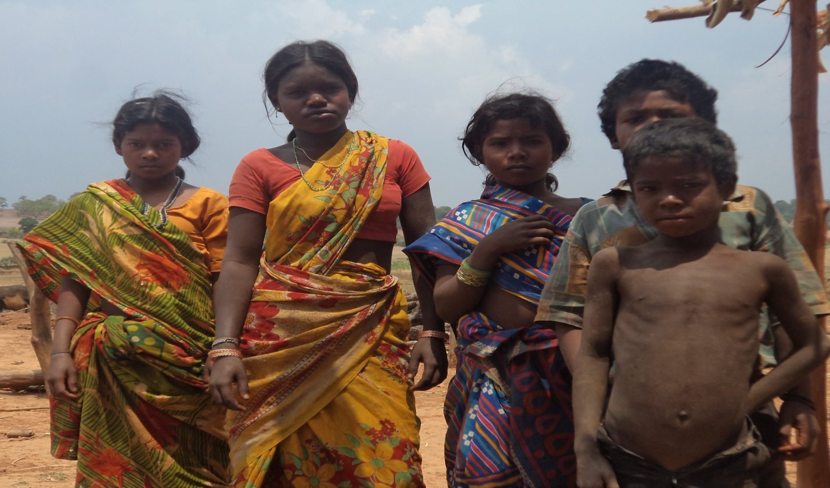
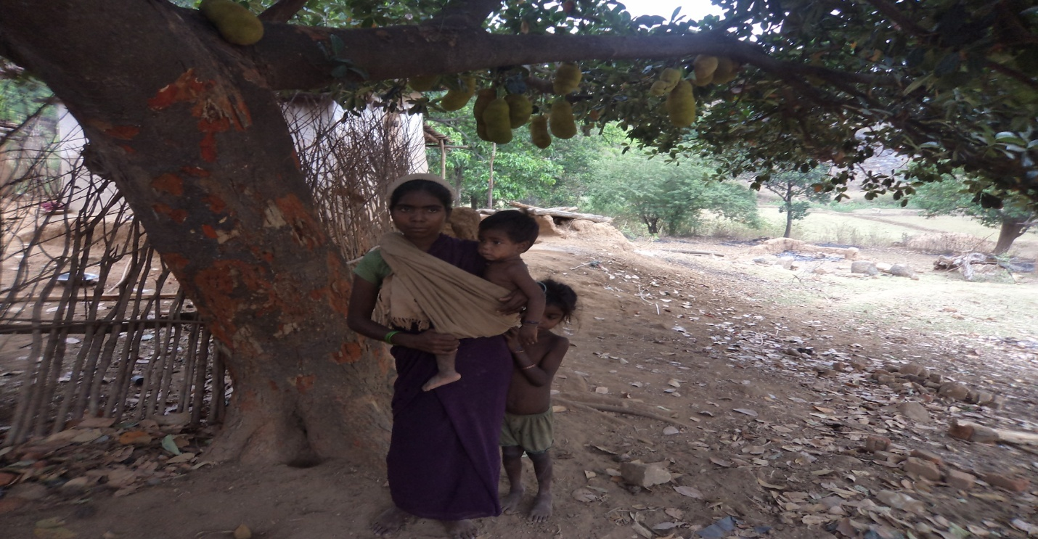
Maternal Health Care and Practices of Hill Korwa
Introduction :
Hill Korwa is one of the five particularly vulnerable tribal group of Chhattisgarh. Hill Korwa named as PVTG because of certain features(1)Extreme Poverty(2) Low level of Literacy(3) Primitive Technology(4)Declining Population.

Slide 2
Objectives
Antenatal and Postnatal care,
Place of Child Birth,
Traditional practices regarding Maternity .
Methodology
The study was taken place in twelve villages of Bagicha and Manora blocks of Jashpur district.
The samples get collected by the purposive sampling method where only those women are interviewed who goes through the maternity phase.
The sample consists of 101 Hill Korwa women of 18 to 50 years age groups.
Tool used for the data collection was semi-structured interview-schedule, Questionnaire , interview guide and camera.
It was a Descriptive study.

Slide 3
Result and Discussion
Antenatal and Postnatal care
73.3 percent respondents received ANC service by ANM during the field visits..
85.1 percent respondent are not been aware about the institutional delivery as well as the facility of cash incentives benefit of the government.
61.2 percent new born child get immunized.
Place of Child Birth
92.1 percent Hill Korwa women give child birth at Kumba.
Only 7.9 percent women prefers health centre for delivery.
Traditional practices regarding Maternity
Taboos
Coved Practices

Slide 4
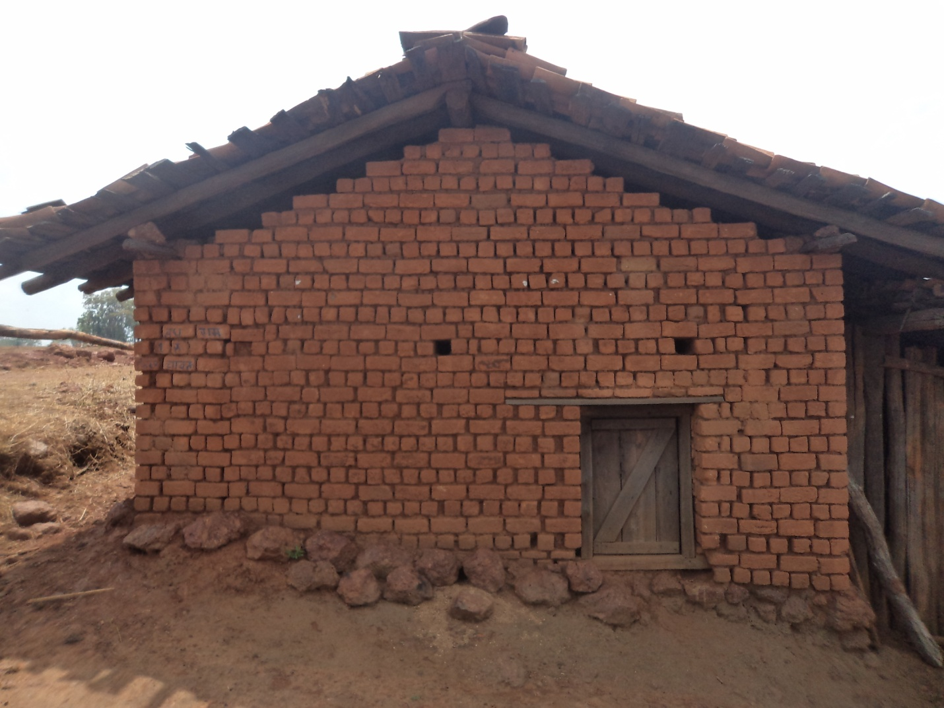
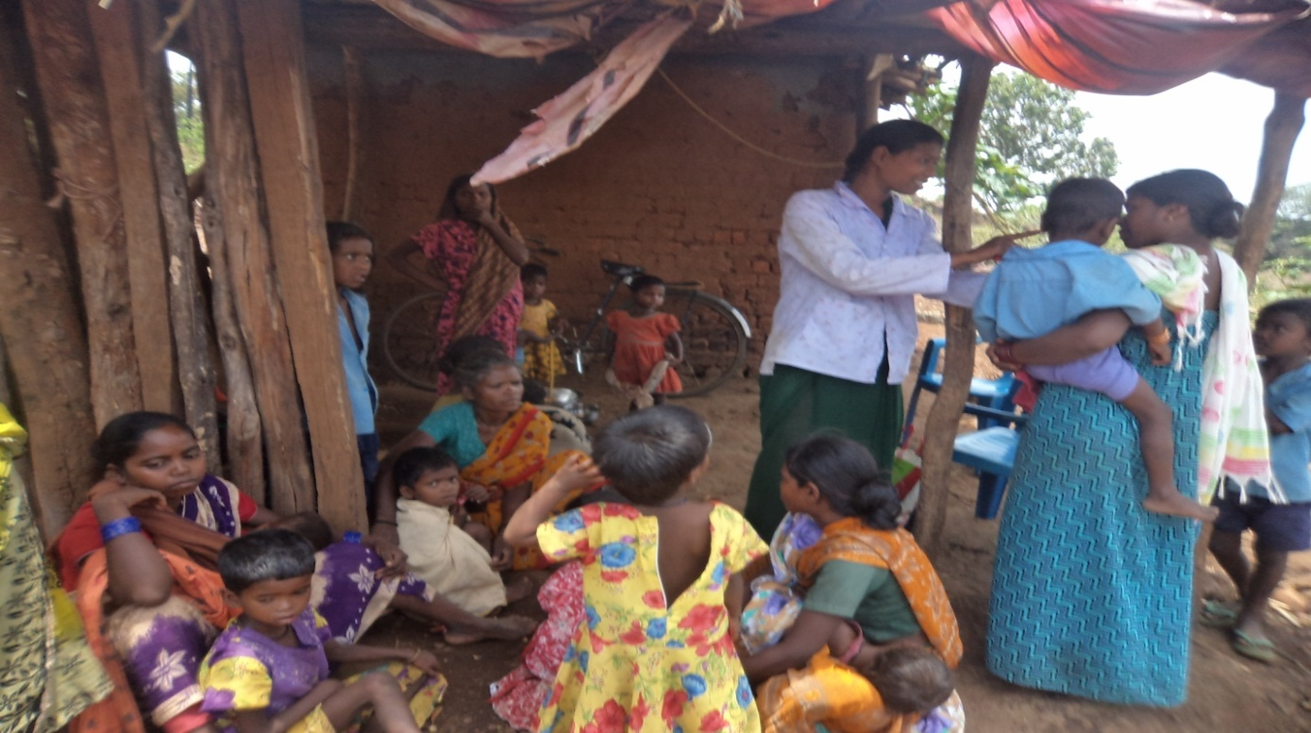
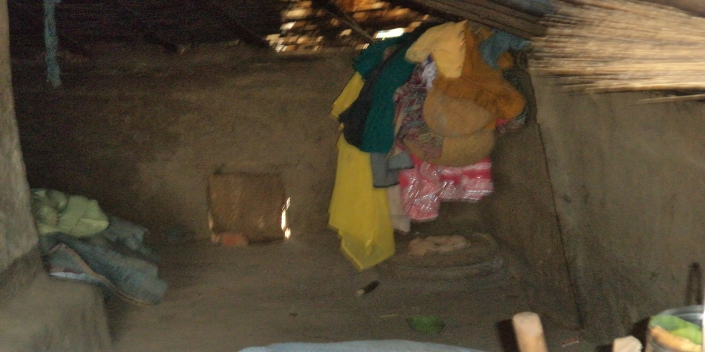
Picture shows Kumba and ANM field visit

Slide 5
THANK YOU
Dr. Rashmi Kujur,
Asst. Professor,Sociology,
Govt. Pt. S.C.Shukla College ,Dharsiwa

